Slide 1


Slide 2
Geo Replication
TGIP-CN
Episode 004

Slide 3
Cluster
Identified by a cluster-name
Cluster name is used for configuring geo-replication
Cluster configuration
Web service url (http://)
Web service url tls (https://)
Broker service url (pulsar://)
Broker service url tls (pulsar+ssl://)

Slide 4
Cluster Setup
$ bin/pulsar initialize-cluster-metadata \
--cluster pulsar-cluster-1 \
--zookeeper zk1.us-west.example.com:2181 \
--configuration-store zk1.us-west.example.com:2181 \
--web-service-url http://pulsar.us-west.example.com:8080 \
--web-service-url-tls https://pulsar.us-west.example.com:8443 \
--broker-service-url pulsar://pulsar.us-west.example.com:6650 \
--broker-service-url-tls pulsar+ssl://pulsar.us-west.example.com:6651

Slide 5
Cluster Operations
Create
Get
Update
List

Slide 6
Geo Replication
Cluster 2
Cluster 1
Cluster 3

Slide 7
Global Config Store
Cluster 2
“Cluster 1”: … “Cluster 2”: …
“Cluster 3”: …
Cluster 1
ZooKeeper
ZooKeeper
Global ZooKeeper
Cluster 3

Slide 8
Allowed Clusters & Replicated Clusters
`bin/pulsar-admin tenants create --allowed-clusters <clusters-list>`
`bin/pulsar-admin namespaces create --clusters <clusters-list>`

Slide 9
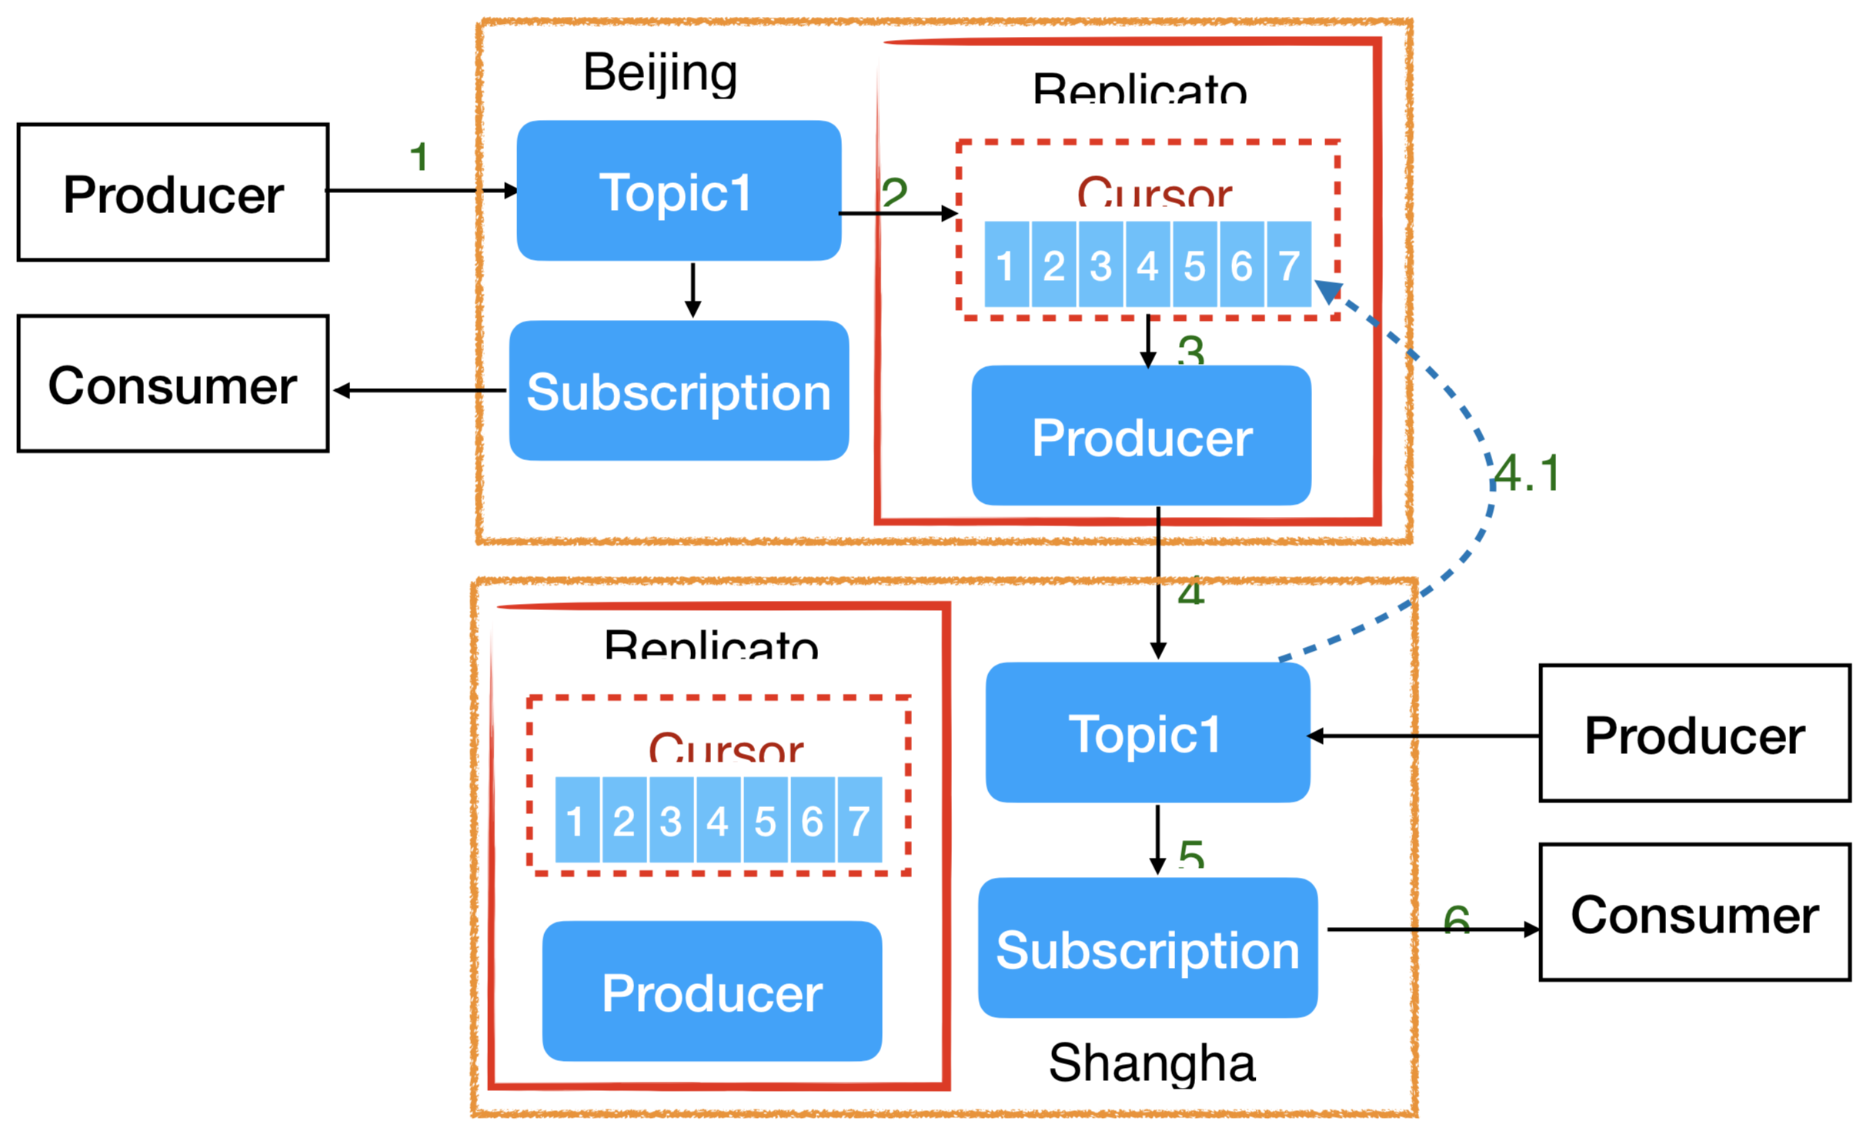
Geo-Replication

Slide 10
Demo
Configuration Store
pulsar-sfo-zookeeper
Two clusters
pulsar-sfo-1
pulsar-sfo-2

Slide 11
Geo-replication w/o
Global ZK
Cluster 2
ZooKeeper
ZooKeeper
ZooKeeper
Cluster 1
“Cluster 1”: … “Cluster 2”: …
“Cluster 3”: …
ZooKeeper
ZooKeeper
ZooKeeper
ZooKeeper
ZooKeeper
ZooKeeper
“Cluster 1”: … “Cluster 2”: …
“Cluster 3”: …
Cluster 3
“Cluster 1”: … “Cluster 2”: …
“Cluster 3”: …

Slide 12
Aggregation Pattern
Cluster 4
ZooKeeper
Cluster 1
ZooKeeper
ZooKeeper
ZooKeeper
ZooKeeper
ZooKeeper
Cluster 2
“Cluster 1”: … “Cluster 4”: …
ZooKeeper
ZooKeeper
Cluster 3
ZooKeeper
ZooKeeper
ZooKeeper
ZooKeeper
“Cluster 3”: …
“Cluster 4”: …
“Cluster 2”: … “Cluster 4”: …

Slide 13
Failover Pattern
Active
Standby
ZooKeeper
ZooKeeper
ZooKeeper
ZooKeeper
ZooKeeper
ZooKeeper
“Active”: … “Standby”: …
“Standby”: …

